Slide 1
Urban Sprawl in Madison,WI, and Beyond
Toby Lunt and Tuan Tran
October 2012

Slide 2
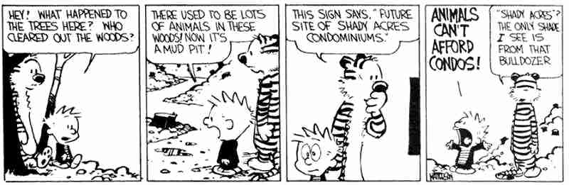
Animals Can’t Afford Condos

Slide 3
So…what is sprawl?
Defined: the spreading of urban developments (as houses and shopping centers) on undeveloped land near a city [Merriam Webster]
Low Density development
Also, spreading of development onto land with a historically different use
For example: converting farmland to a shopping mall

Slide 4
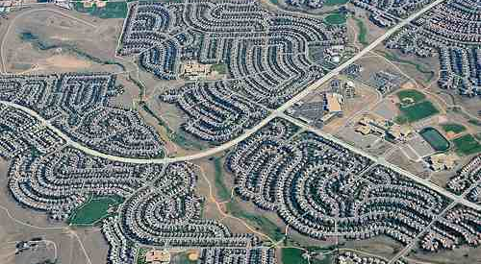

Slide 5
Sprawl in the US - general
Pros
Temporarily solve the demanding need of land in central business districts
Cons
Partitioned land use
Create more traffic and land used for commuting
Decrease in social capital
Increase resource usage (transportation and infrastructure cost, water and land, etc.)

Slide 6
Tax issues
As city expands through sprawl, property taxes rise, and land is no longer cheap enough to farm
Conversion of some of the most productive agricultural land in the WORLD to parking lots and convenience stores
Benefit: farmers can sell their land for a lot of money when they retire
BUT: this can only happen once. When the land is gone, it’s gone for a long, long time.

Slide 7
Tax issues
Often, sprawl occurs in surrounding townships outside of a city
These townships take advantage of public services that are provided by the city, but don’t pay for them
Roads
Electricity infrastructure
Public transit
Less dense population means more infrastructure required for same level of services – more expensive
This can raise tax rates in the city, in addition to tax rates going up in the surrounding areas

Slide 8
Further Issues
Increased dependence on private cars for transportation
Climate change driver
Increased pollution
Traffic fatalities
Habitat destruction and fragmentation

Slide 9
So why does it happen?
Home Buyers Like:
More acreage at lower cost per acre
Lower population density
Newer, larger homes
Less crime, less property tax than city living
Distance from city pollution
More natural environment
Friendlier neighborhoods
Ironically, sprawl threatens many of these qualities

Slide 10
How Sprawl Affects Madison
The 110,127 people living in exurban communities in [the Madison area] represented 21.9 percent of total metropolitan population. On this count, the Madison, WI metro area ranked number 5 among the 88 largest metro areas.¹
Madison: incorporated 1848. Population of 236,901 (increased by 20% in the past 20 years). 174 km². Population density of 1,361/km². ²
Fitchburg (suburb): incorporated 1983. In 2011, population of 25,665 (increased by 59% in the past 20 years). 90.39 km². Density of 227/km². ²

Slide 11
How Sprawl Affects Madison
Property taxes in Dane County rising 3.57 times faster than population is growing!
Short “rush hour” is growing – more traffic
Decreased community ties because of decentralization
Specialized zoning fragments community functions
Water pollution

Slide 12
Growth Trends in Madison
Like many other urban areas, the municipalities surrounding Madison have grown much faster than the city itself since 1970
This trend requires an increase in public services:
Road construction
Energy
Wastewater treatment
Schools, fire, police
These services are more spread out, and cost more money per citizen than in urban centers

Slide 13
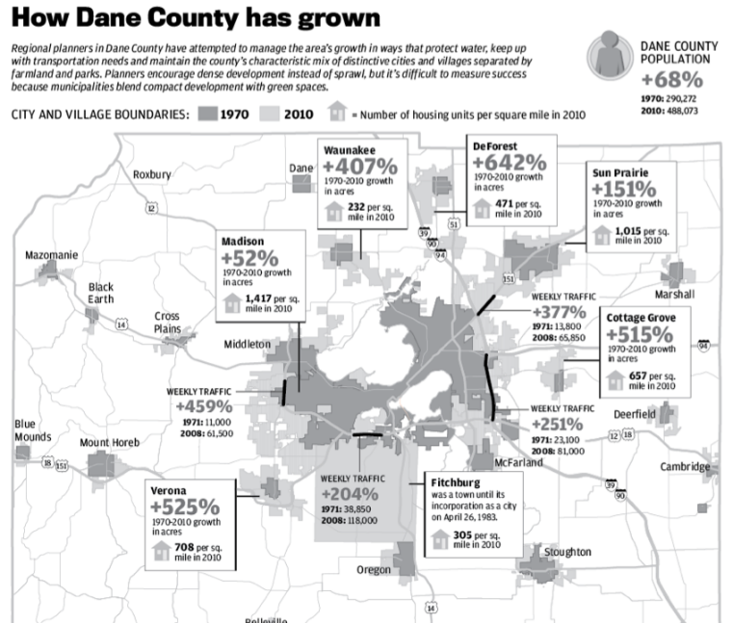
BIGGER SUBURBS
MORE TRAFFIC

Slide 14
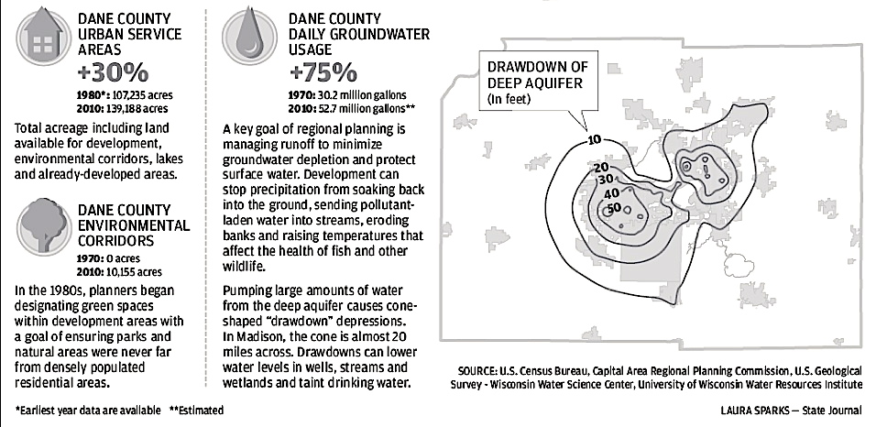
Growth and Sprawl Burden Local Aquifers.

Slide 15
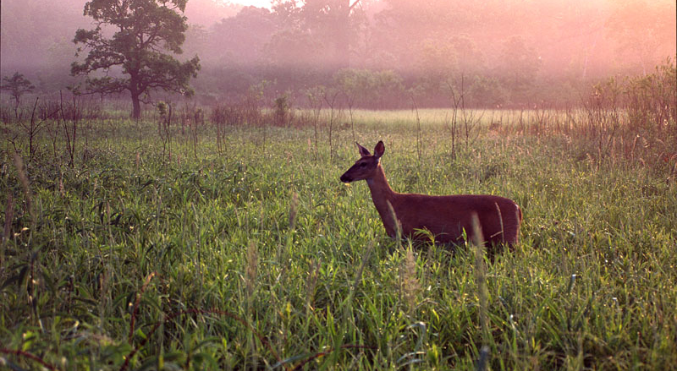
UW Madison Arboretum: a Case Study

Slide 16
UW Madison Arboretum
Established in the early 1930s
Many different restored ecotypes:
Prairies
Deciduous forest
Conifer forest
Wetland
Also many horticultural plants

Slide 17

UW Madison Arboretum
Some of the best examples of restored prairie in the country
Greene Prairie was handplanted in the 1940s and 1950s – 12,000 seedlings planted by hand
Almost all prairie has been destroyed by agriculture and other development
0.09% of the original tallgrass prairie remains

Slide 18
Arboretum Battles Sprawl
80 acre housing development called Harlan Hills proposed in the mid 1990’s
Right next to the Arboretum’s Greene Prairie
Huge resistance from Arboretum and general public
Didn’t want to jeopardize the Greene Prairie
Significant aesthetic degradation – could see big houses from the Prairie if developed
Large battle, zoning conflicts, ultimately developer won
Turned down Arboretum’s offer to buy the land – developer wanted double the land’s appraised value

Slide 19

Developer made his millions by breeding and selling lab rats

Slide 20
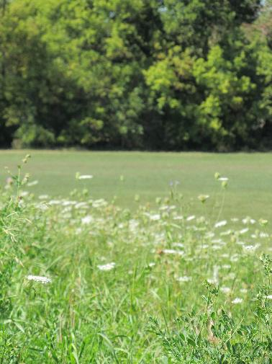
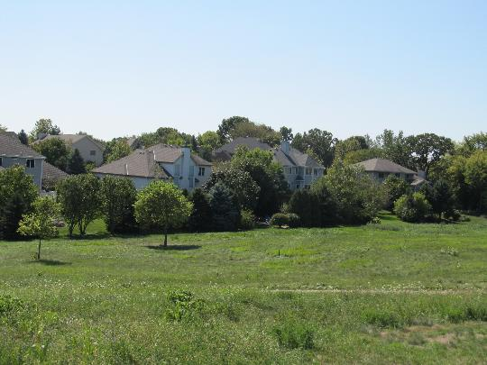
Harlan Hills

Slide 21
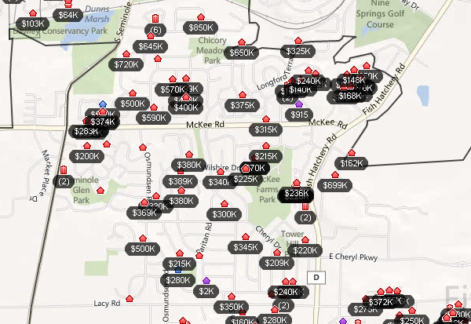
High property prices in Harlan Hills area

Slide 22
High property prices in Harlan Hills area
Ironically, property values are higher when they are closer to the arboretum!

Slide 23
The Main Problems:
Sprawl and development in nearby areas overload the Dunn’s Marsh watershed
Heavy rains now flood the prairie, which deposits invasive weed seeds
Greene Prairie biodiversity slowly being taken over by Reed Canary Grass

Slide 24
The Consequences
Greene Praire now threatened by invasives
$200,000 spent in 2000 on a new storm sewer to capture stormwater overflow
$88k from the city of Madison
$12k from the city of Fitchburg
$50k each from Arboretum and Harlan Hills
Arboretum pays $50,000 to solve a problem it did not cause!

Slide 25
'What this means to me is that the rich have won out again,'' said Fitchburg resident Steve Sander.
''There is going to be no way to hide those houses once they're built,'' said Karla Bukstein. ''There are no earth tones that can conceal them. Greene Prairie will be changed forever.''

Slide 26
Conversely…
The Harlan Hills development is full, and filled up quickly. There is a strong demand for homes constructed in this development.
Clearly some people value the amenities provided by the Harlan Hills, and are either not aware of the downsides or simply don’t care about them.

Slide 27
The End
“Sprawl is bad aesthetics; it is bad economics. Five acres are being made to do the work of one, and do it very poorly. This is bad for farmers, it is bad for communities, it is bad for industry, it is bad for utilities, it is bad for railroads, it is bad for the recreation groups, it is even bad for the developer.”
(William Whyte, Editors of Fortune Magazine, 1958. 134-135.)
"I look around here and see a lot of green space. Not much congestion. Good agricultural land, which they pretend to want to save, has not been touched hardly at all…I love the farm, and I would never sell a lot. But if I have to, I don't want anybody to tell me I can't.”
(Lyman Anderson, former Dane County Supervisor and farmer)

